Slide 1
VEHICLE RENTING SERVICE
ROSHAN KUMAR SHARMA
(2000102066)
VIKAS MISHRA
(1700101199)

Slide 2
ABOUT THE PROJECT
THIS PROJECT IS A VEHICLE RENTING SERVICE PROJECT WHICH IS MADE FOR ORGANIZATIONAL NEEDS TO ASSIST THE EMPLOYEES OF THE ORGANIZATION DEALING WITH CUSTOMERS.
THE OBJECTIVE OF THIS PROJECT IS TO MAKE THE RESERVATION OF CAR EASY FOR THE CUSTOMERS AND EMPLOYEES .
THIS PROJECT IS BASED ON JAVA CODING AND MYSQL DATABASE.
THIS PROJECT CAN BE USED TO BOOK A CAR IN AN ORGANIZATION OR COMPANY.

Slide 3
OBJECTIVES
a) Customer’s registration: The system should allow new users to register and generate membership card.
b) Reservation of cars: Customers should be able to use the system to make
c) Booking and reservation.
d) Automatic update to database once reservation is made or new customer registered: Whenever there’s new reservation or new registration, the system should be able update the database without any additional efforts from the admin.
e) Feedbacks to customers: It should provide means for customers to leave feedback.

Slide 4
REQUIREMENTS
Software Requirements
Java/JDK
Net Beans
MySQL
SQL YOG
Hardware Requirements
Pentium IV Processor
512 MB RAM
40 GB HDD
Color Monitor
Keyboard, Mouse

Slide 5
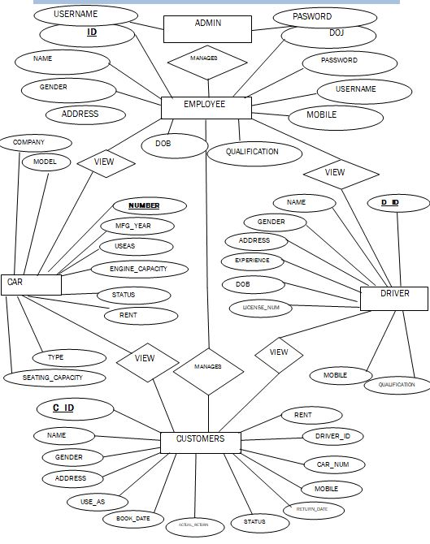
FLOW CHART OF PROJECT

Slide 6
VEHICLE RENTING SERVICE MODULES
ADMIN
EMPLOYEE
INVOICE MANAGEMENT

Slide 7
EMPLOYEE MODULE
IN THIS MODULE EMPLOYEE HAS THE PRIVILEGE TO SERVE THE CUSTOMER AND DRIVERS ALSO BY VARIOUS MEANS LIKE :-
1)ADDING DRIVER
2)MODIYING DRIVER DETAILS
3)ACCESSING ALL THE LIST OF DRIVERS AND CARS
4)BOOKING CAR
5)BILLING THE RENT OF THE CAR WHEN RETURNED BY CUSTOMER

Slide 8
ADMIN MODULE
IN THE ADMIN MODULE , ADMIN CAN ACCESS ALL THE DATA OF THE DRIVERS , CARS , EMPLOYEES ETC..
IT ALSO HAS FOLLOWING OPTIONS :
1)ADDING EMPLOYEES
2)MODIFYING THE INFORMATION OF THE EMPLOYEES
3)ADDING COMPANY
4)ADDING CAR
5)ACCESSING THE LIST OF ALL DRIVERS , EMPLOYEES.

Slide 9
TESTING ON PROJECT
Black Box Testing- Not based on any knowledge of internal designs or code. Tests are based on requirements and functionality.
White Box Testing- Based on the knowledge of the internal logic of an application’s code. Tests are based on coverage of code statements, branches, paths and statements.
Integration Testing- Testing of combined parts of an application to determine if they function together correctly. The ‘parts’ can be code modules, individual applications, client and server applications on a network, etc. This type of testing is especially relevant to client/ server and distributed systems.
User Acceptance Testing- Determining if software is satisfactory to an end user customer

Slide 10
LIMITATIONS OF PROJECT
The Vehicle Renting Service is only limited to the home country which means it only rents car inside the country border it only gives three option city ride , state ride and country ride .
Car renting system does not deal with the situations in which if any accident or damage occurs it only deals with the fine for delays in return date , the system does not calculate for the damage done to the car.
Special characters like @, #, *, & etc.. in text fields are allowed.
There is no specified length restriction given to the username and password field and both fields accept alphanumeric value.

Slide 11
THE END
THANK YOU

